Slide 1
ONE INNOVATION HUB AI CLASS
UNSUPERVISED LEARNING ALGORITHMS

Slide 2
INTRODUCTION
Unsupervised ML algorithms are algorithms used to solve unsupervised ML problems.
Unsupervised ML is a type of ML problem in which the target feature/class is NOT labelled.
As a result, the computer is supposed to derive insights from the dataset and classify the data based on this insight.
The most common method is CLUSTERING

Slide 3
INTRO TO CLUSTERING
It is a type of unsupervised ML method which the algorithm is made to learn from a data with unlabeled output and draw out inferences.
These inferences will then be the basis with which the data is split in categories.

Slide 4
Clustering is the task of dividing the population or data points into a number of groups such that data points in the same groups are more similar to other data points in the same group and different from the data points in other groups.
It is basically a collection of objects on the basis of similarity and dissimilarity between them.

Slide 5
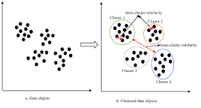
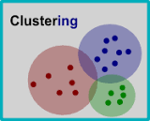

Slide 6
TYPES OF CLUSTERING
Centroid-base Clustering
Density- based Clustering
Distribution-based Clustering
Hierarchical Clustering

Slide 7
HIERARCHICAL-BASED CLUSTERING
As the name implies, this works by creating clusters of trees in a hierarchical format, that is, a single tree forms new clusters and the news are formed from previously formed ones.
This is similar to the approach discussed in Decision tree. It is created through 2 approaches;
1. Top-down approach (Divisive)
2. Bottom-up approach (Agglomerative)

Slide 8
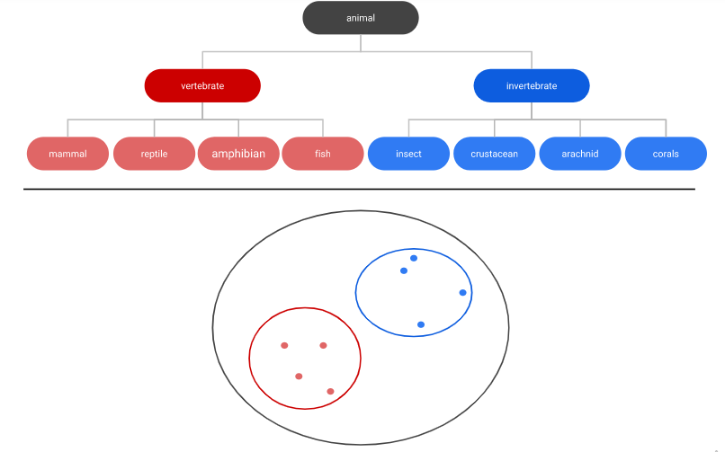

Slide 9
DISTRIBUTION-BASED CLUSTERING
This approaches the dataset based on the assumption that the is an intrinsic method of distribution in it.
Such distributions can be Guassian, Normal etc and this algorithm then makes its clusters based on this distribution
As the distance from the distibution center increases, the probability that the datapoint belongs to that group is decreased.

Slide 10
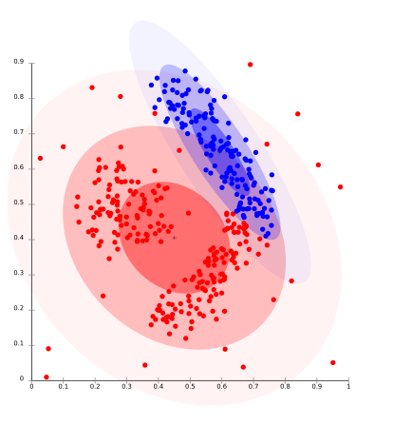

Slide 11
DENSITY-BASED CLUSTERING
This approaches works based on density of datapoint.
That is, it connects area of high density together because it assumes that since there is high density there, there should be some sort of similarities.
These algorithms have difficulty with data of varying densities and high dimensions.
It also does not assign outliers into the the clusters

Slide 12
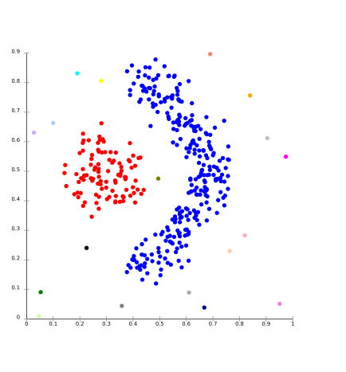
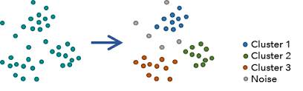

Slide 13
CENTROID-BASED CLUSTERING
This is the commonest form of clustering.
This is an iterative clustering algorithm in which these clusters are formed based on how close the datapoints are to the CENTROID.
A centroid is formed in such a way that the distance of datapoints is minimum with that particular centre. This is similar to our discussion in Support Vector Machine.

Slide 14
Therefore, the clusters are then formed based on the closeness of datapoints to the centroid of the clusters.
Depending on the amount of the clusters, the datapoints are segregated/partitioned based on nearness and similarities.

Slide 15
K-MEANS CLUSTERING ALGORITHM
It is the simplest unsupervised learning algorithm that solves clustering problem.
Iteratively determines the best k center points (known as centroids).
Assigns each example to the closest centroid. Those examples nearest the same centroid belong to the same group.

Slide 16
K-means algorithm partitions n observations into k clusters where each observation belongs to the cluster with the nearest mean serving as a prototype of the cluster.
The k-means algorithm picks centroid locations to minimize the cumulative square of the distances from each example to its closest centroid.

Slide 17
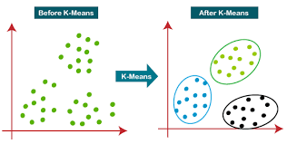
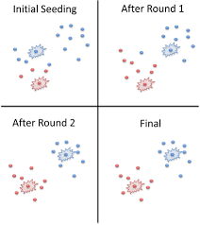

Slide 18
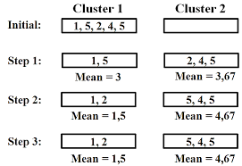
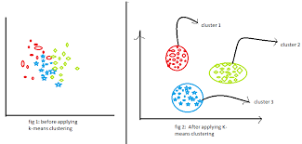

Slide 19
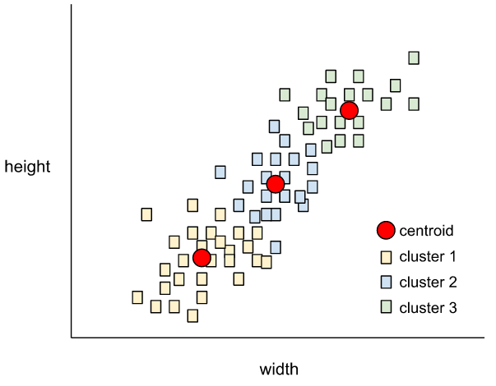
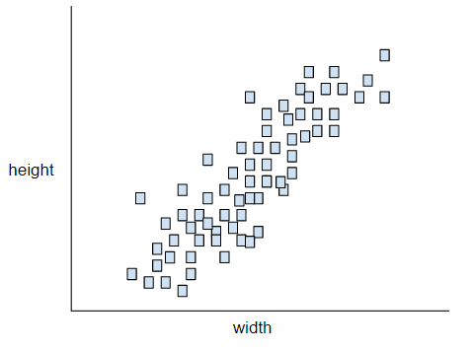

Slide 20
HOW K-MEANS WORK?
Step 1: Initialize k points, called means, randomly.
Step 2: Categorize each item to its closest mean and update the mean’s coordinates, which are the averages of the items categorized in that mean so far.
Step 3: Repeat the process for a given number of iterations and at the end, we have our clusters.

Slide 21

EUCLIDEAN DISTANCE
k-means relies on the Euclidean distance from the centroid to an example. (In two dimensions, the Euclidean distance means using the Pythagorean theorem to calculate the hypotenuse.) For example, the k-means distance between (2,2) and (5,-2) would be:

Slide 22
APPLICATION OF CLUSTERING
Marketing: It can be used to characterize & discover customer segments for marketing purposes.
Biology: It can be used for classification among different species of plants and animals.
Libraries: It is used in clustering different books on the basis of topics and information.
Insurance: It is used to acknowledge the customers, their policies and identifying the frauds.
City Planning: It is used to make group

Slide 23
REFERENCES
Clustering in Machine Learning https://www.geeksforgeeks.org/clustering-in-machine-learning/?ref=lbp
K means Clustering – Introduction https://www.geeksforgeeks.org/k-means-clustering-introduction/?ref=lbp
Different types of clustering algorithm https://www.geeksforgeeks.org/different-types-clustering-algorithm/?ref=lbp

